Slide 1
Apartment rental PRICE PREDICTION
Satria Said – DS32A

Slide 2

README
🎓 Education: Mining Engineering (ITB) + Master's in Predictive Analytics (Curtin University)
💼 Experience: AdOps Specialist, Programmatic Campaign Manager, Research Assistant - specialized in data-driven solutions & mining safety
🎯 Passion: Bridging traditional mining with cutting-edge analytics to enhance operational efficiency & sustainability

Slide 3

Previous projects
DEEP LEARNING
PYTHON
ML in R
Indonesian Tweet Sentiment Analysis
Beezness: Bee Farm Modelling with Python
Student Performance Predictive Analysis with R

Slide 4
Table of contentS
01
04
Business Understanding
modelling
02
DATA Preparation
03
DATA UNDERSTANDING
05
EVALUATION
06
DEPLOYMENT

Slide 5
01
BUSINESS UNDERSTANDING

Slide 6

Problem statement
Imagine you’re scrolling through countless apartment listings, each listing promising something different—luxury amenities, prime locations, pet-friendly policies, and every price tag imaginable. How do you decide which listings are worth your time, or even predict which features make an apartment more appealing or expensive?

Slide 7
BUSINESS OBJECTIVES
Develop a predictive model to accurately estimate apartment rental prices based on property characteristics, location, and amenities to support:
Property investment decisions
Pricing strategy optimization for landlords
Market valuation for real estate platforms
Rental budget planning for tenants

Slide 8
02
Data Preparation

Slide 9
BUsiness understanding
Data Source
UCI ML Repository – Apartment for Rent Classified
v
Data Size and Features
100,000 apartment listings
22 variables covering property details, location, and amenities.
x
Geographic Coverage
United States
?

Slide 10
success metrics
Model performance RMSE < $350 and MAPE < 20%.
Identify top 4 most influential pricing factors.
Deploy model for real-time price estimation.

Slide 11
03
Data Preparation

Slide 12
Data cleaning
<1% Data DUPLICATION
<1% missing values
<1% outlier
The data is relatively low in duplication, but duplicates were removed.
The data is relatively low in missing values, but missing values were removed.
The data has outliers especially on the rent price, the outliers were removed to make the distribution more normal.

Slide 13
FEATURE ENGINEERING
To ensure the model can capture the pattern in the data, below are the feature engineering methods used:
MEAN ENCODING
Feature Selection
Minmax scaling
categorical encoding
These columns 'category','has_photo’,
'cityname','state’,
'source’
were encoded based on the average rent price for each category within the column.
These features were dropped to streamline the analysis
'id', 'title','body','currency','price_display','address','latitude','longitude','price_type','time'
After all data were encoded, the entire features were scaled using minmax scaler.
The ”fee” column is the only feature to be encoded from Yes/No to 1/0

Slide 14
04
EXPLORATORY DATA ANALYSIS

Slide 15
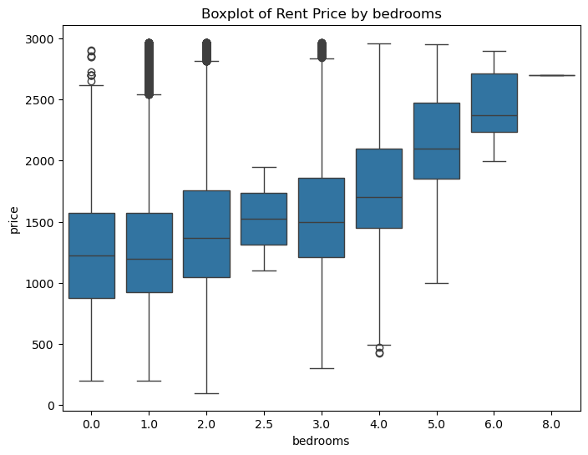
Exploratory data analysis
INSIGHTS
The higher the number of bedrooms, the higher the average rent price tends to be. This also applies to the number of bathrooms.
The average rent price tends to be higher when there are no pets allowed.
The average rent price tends to be higher when the floor is wood.

Slide 16
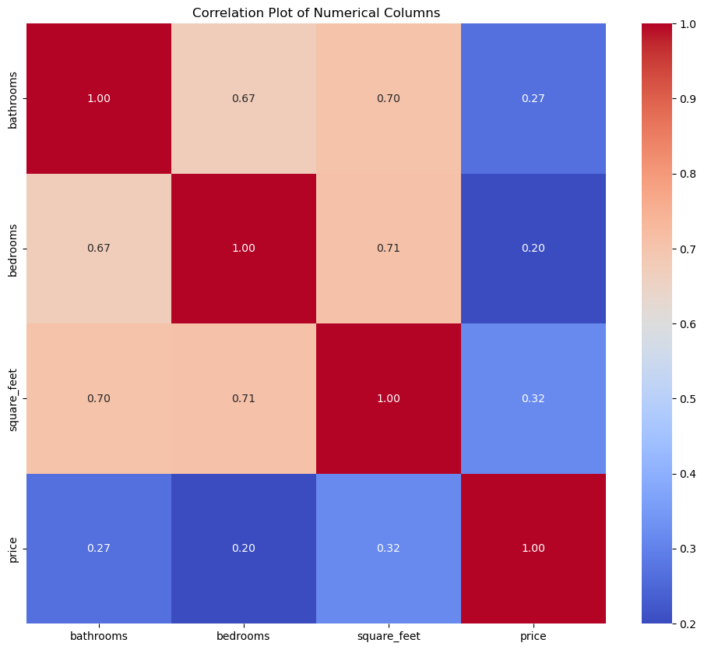

Exploratory data analysis
INSIGHTS
There is a moderate-to-high correlation between the number of bedrooms, bathrooms, and square feet
A low-to-moderate correlation between price and square feet, number of bathrooms, and number of bedrooms.
Based on the VIF score, the suspected correlated features have moderate correlation, hence it is considered okay not to remove anything.

Slide 17
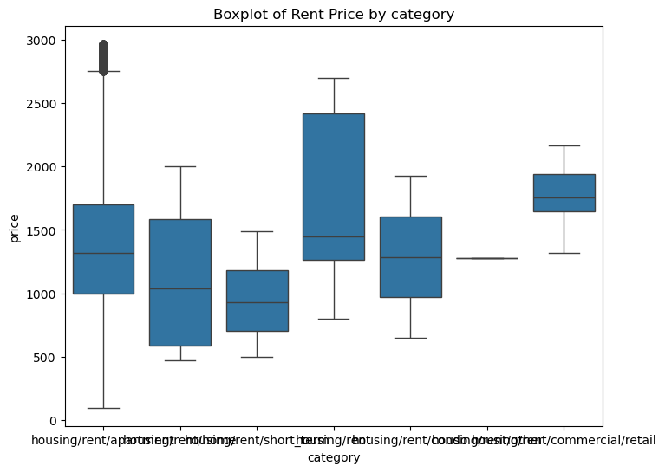
Exploratory data analysis
Several more INSIGHTS
Retail-type property has the highest average price compared to the other property types. The writer thinks that this is normal because the retail type data has less information compared to the other property types.
If the property has no additional fees, the average rent price is higher.
If the property listing has a thumbnail photo, the average rent price is higher.
The larger the property (in square feet), the higher the average rent price.

Slide 18
05
MODELLING

Slide 19
Algorithm and strategy
Algorithm selection
Model development strategy
Evaluation metrics
Linear Regression
Decision Tree
Random Forest
XGBoost
CatBoost
Deep Learning
Train/Test Split: 80 : 20
Cross -v alidation with 5-fold CV for more robust performance estimation
Hyperparameter Tuning with Grid Search for optimal parameters
Feature Importance to analyse which variables drive predictions
Primary: RMSE and MAPE
Secondary: R² and MAE

Slide 20
06
evaluation

Slide 21
Model evaluation analysis
MODEL | RMSE | MAPE | mae | r²
Linear regression (REVEALED NON-LINEAR RELATIONSHIP) | $ 363.75 | 21.36% | $ 273.21 | 52.37%
Decision Tree | $ 380.64 | 17.59% | $ 229.69 | 47.84%
Random Forest (HP Tuned) | $ 278.23 | 14.09% | $ 181.95 | 72.13%
XGBoost (HP Tuned) | $ 278.51 | 14.98% | $ 193.49 | 72.08%
CatBoost (HP Tuned) | $ 287.78 | 15.86% | $ 204.72 | 70.18%
Deep Learning | $ 287.72 | 22.52% | $ 287.72 | 47.00%

Slide 22
07
DEPLOYMENT

Slide 23
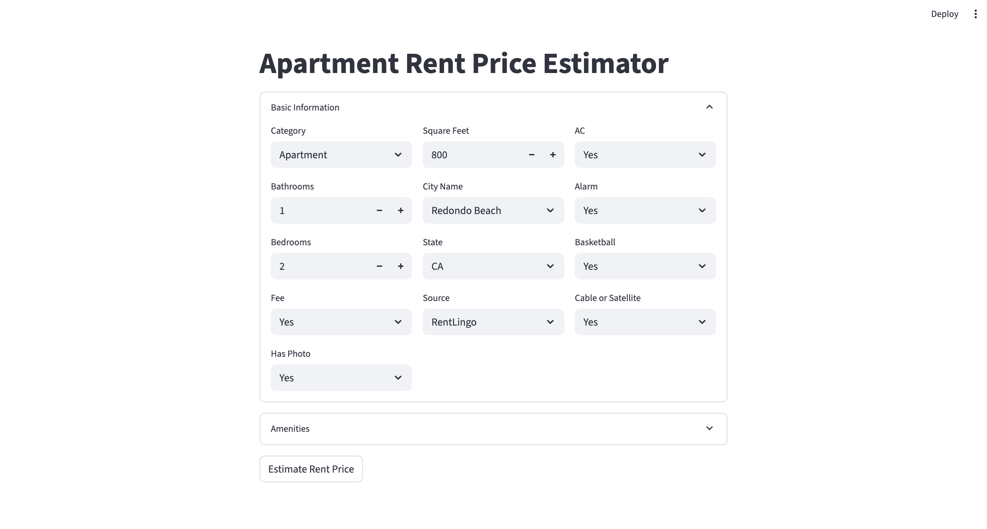


Slide 24
08
CONCLUSION & RECOMMENDATION

Slide 25
Conclusion
Recommendation
RF (the best) and XGBoost performed better for this dataset
Urge property owners to provide complete information
1
1
2
2
Not allowing pets in their property to increase the rent price.
The state where the rent is located becomes the most influential factor. The higher the average rent price of that state, the higher the rent price. Additionally, apartment size (in sq. ft), number of bathrooms, and the city are influential factors.

Slide 26

Thanks!
Do you have any questions?
satriasaid@gmail.com
www.linkedin.com/in/satriahpsaid/
Please keep this slide for attribution.

